Slide 1

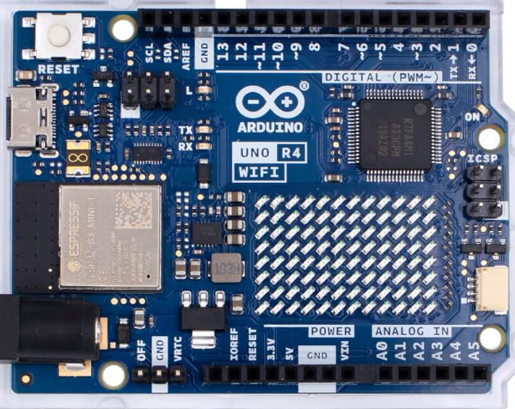

Wireless Embedded Fire suppression system
Nate Mosk
5/30/2025

Slide 2
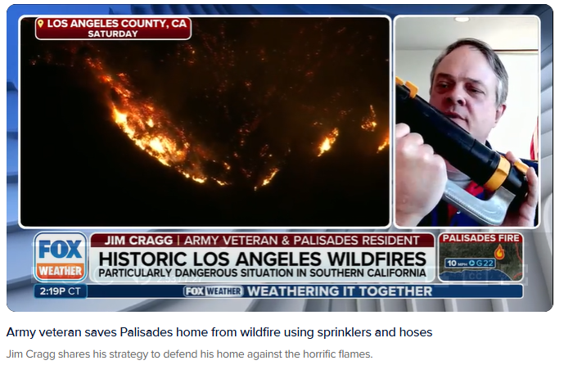

Real life example of fire protection
During the LA fires in 2025, a man saved his home by placing simple lawn sprinklers on the roof
Army veteran's simple purchase saved home against wildfire in Southern California | Fox Weather

Slide 3




Let’s follow his example and save more homes
Goal: Add a fire suppression system to a house
Controller

Slide 4
Minimum Viable Product:
Goal: Add a fire suppression system to a house
Rooftop system that deploys water
Is controllable via a central computer
System can be turned on by a client’s wireless remote
System can be monitored and used via the internet
Controller

Slide 5


Component 1 – Web server built
A web server has been successfully built and tested with the following specs.:
Arduino R4 Wifi model board is used to host a simple web server
By using port forwarding on my home router, the server can be accessed from the web
HTML Hyperlink buttons on the page are able to be selected by a client to pass data to the server
When a button is clicked, it turns an LED on or off
Status of the LED is displayed on the web page
Internet
Link to video of Webserver
Arduino R4
Router
Vcc
Wifi_connect.ino
https://github.com/nmosk/wes_cap

Slide 6
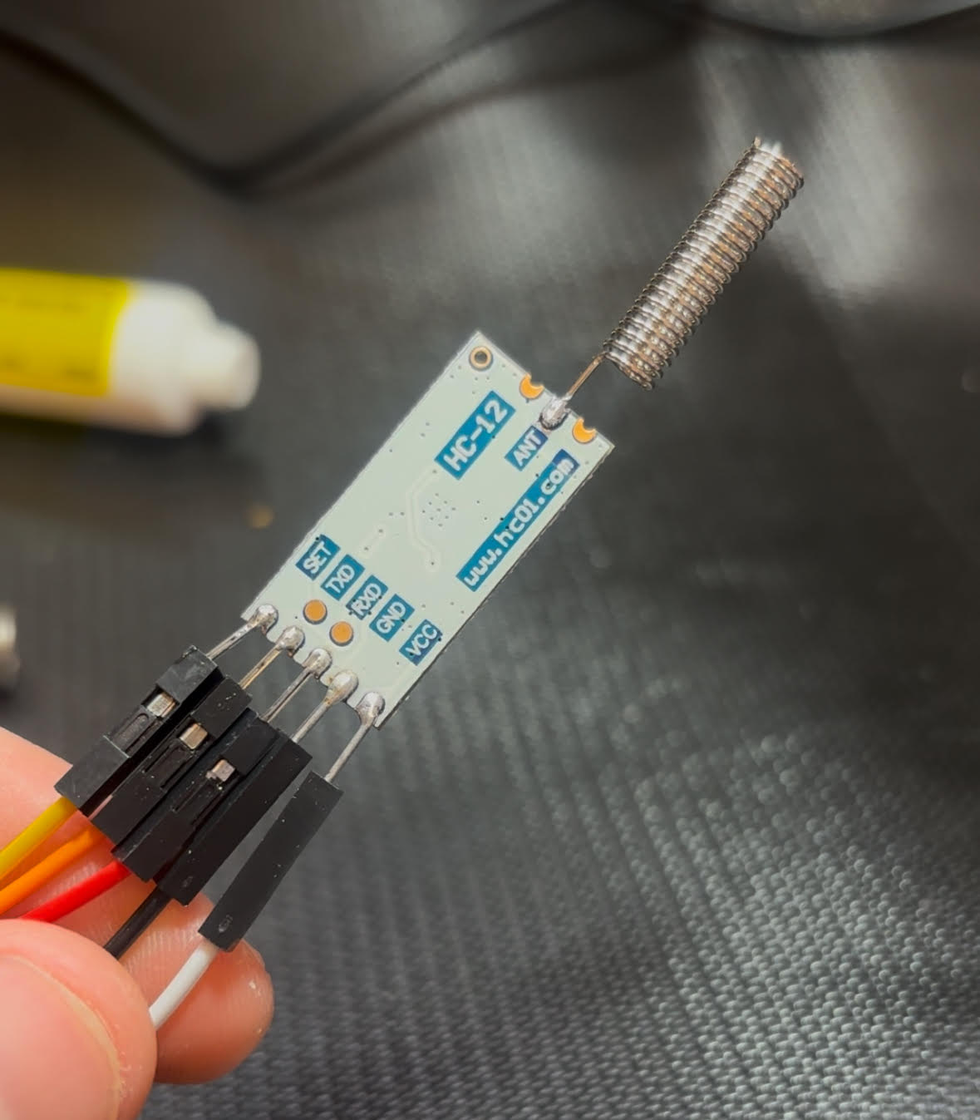
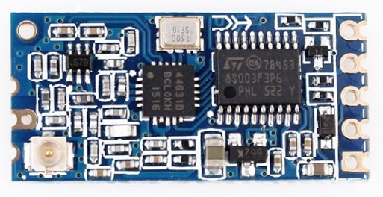
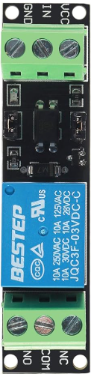
Component 2 – Remote Control built
A remote control has been successfully built and tested with the following specs.:
HC-12 wireless module connects two boards
Arduino Nanos are used to RX/TX information from the HC-12
A button on the transmitter (the remote) is used to send a signal to open and close the “valve”
An LED on the receiver represents the valve and turn on upon reception of a signal from the transmitter
The time and date is logged upon each piece of data received
The remote has a housing and a battery
Double click turns the LED off, single click turns LED on. An algorithm and buffer was developed to facilitate that feature.
Arduino Nano
Link to Video of remote control
Vcc
To valve
Transmitter_button_double-click.ino
Receiver_rev1_button.ino
https://github.com/nmosk/wes_cap
Arduino R4

Slide 7


Component 3 – Relay switch and valve set up
A relay switch and ball valve have been successfully built and tested with the following specs.:
A 3/4” ball valve with an electric actuator motor will serve as the water flow controller
The relay switch is activated by 3.3v control and allows 12 V DC to go through the switch
Link to video of the relay and valve
Arduino R4

Slide 8
Current Achievement – Full assembly
Valve/relay has been installed and connected to board
The web server is combined with the receiver end of the HC wireless module
Both the remote and the website are able to control the relay actuator
The controller computer is installed its housing, as is the remote
The programming code is more readable, highly commented, and well organized than it previously was
Demonstration:
https://www.youtube.com/shorts/zElMQvZ2d8I
https://github.com/nmosk/wes_cap

Slide 9
Next steps – Preparation for Presentation
Need to prepare and create final video – 5 min tops!
Opportunity to improve web server site html
Finalize code repo
Demonstration:
https://www.youtube.com/shorts/zElMQvZ2d8I
https://github.com/nmosk/wes_cap

Slide 10
Video Index and Story board plan
Index:
Link to Video of remote control
Link to video of the relay and valve
Link to video of Webserver
Video of initial HC12 set up
https://github.com/nmosk/wes_cap
Outline of final video:
Show news clips of the fire and explain motivation
Explain concept, design, and plan to build
Use the index of already made videos to show the progression of the project
Show the final product design
Demonstrate the use of the final product
Talk about path forward as a product to help with fires

